Slide 1
SW Illinois Flood
Prevention Project –
Progress Report
October 5, 2011
Council of Owners and Construction Associates

Slide 2
SW Illinois Levee Systems
Designed and built in 1940’s and improved in ‘50s by Corps of Engineers as 500-year levees
Owned and maintained by Levee Districts
  Wood River Drainage and Levee District
  Metro-East Sanitary District
  Prairie DuPont Drainage and Levee District
  Fish Lake Drainage and Levee District
Owned and maintained by Corps
  Chain of Rocks Levee

Slide 3
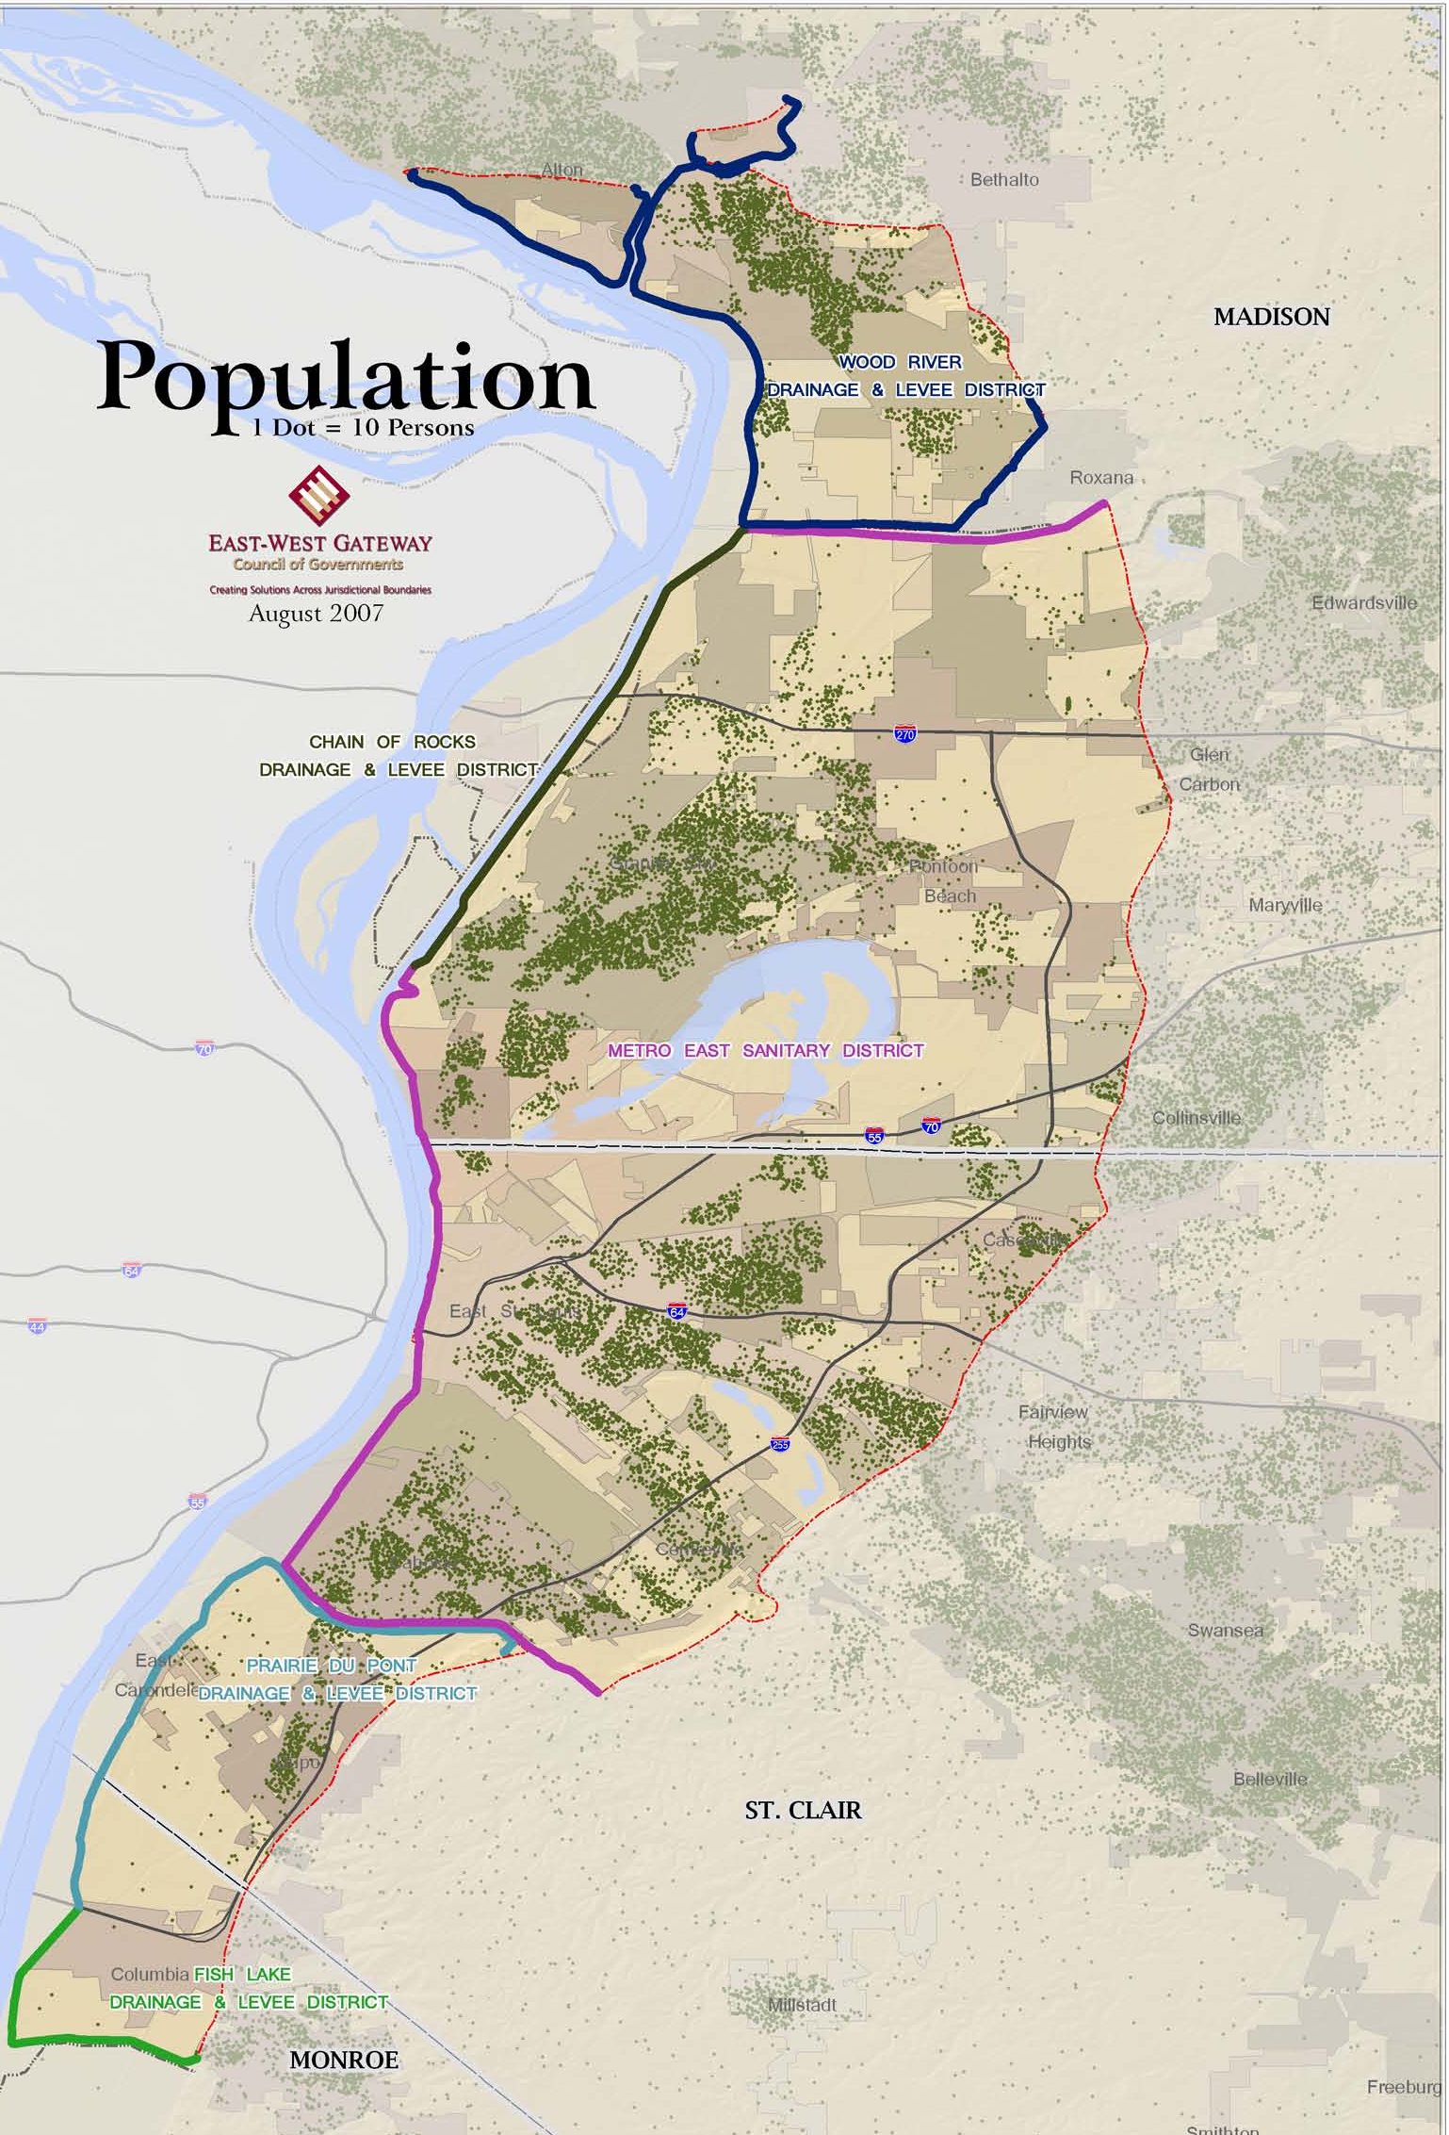
155,000 people
  40% minority
  21% low income
174 square miles
Longstanding and historic communities
  Alton
  Wood River
  Granite City
  East-St. Louis
  Columbia
  Dupo
  East Carondelet
  Collinsville

Slide 4
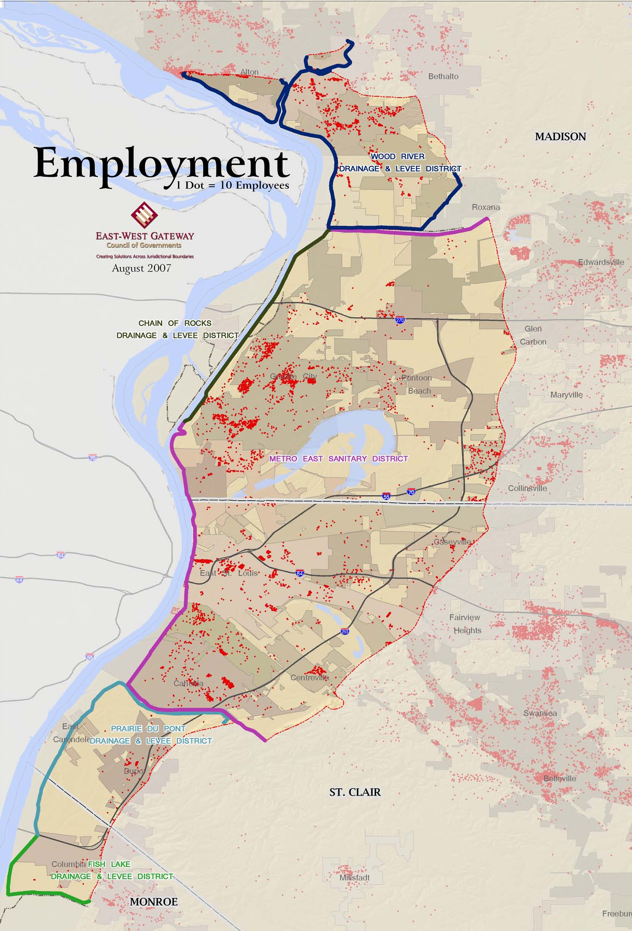
Industrial core of the St. Louis region
55,000+ jobs
  Conoco – Phillips
  U.S. Steel
  Solutia
  Afton Chemical

Slide 5
The Problem
Corps of Engineers identified Design Deficiencies that may compromise the “authorized level of protection” (52 + 2 feet on St. Louis gauge – approx. 500-year)
  Understanding of risk has improved
  Better design methods
  Increased design factor of safety post-Katrina
FEMA decides to de-accredit the levee system
“Fear, uncertainty, and doubt” about flood protection erodes the economic security of Metro-East

Slide 6
Economic Impacts
Mandatory Flood Insurance
  $20 million/yr additional premiums for homeowners and businesses
  Another $30 million/yr for larger businesses
Building Standards
  Raise buildings above base flood elevation
Loss of Property Value
Negative Business Climate

Slide 7
Opportunity
Resurgence of manufacturing
Intergovernmental success story
Renewed marketing opportunities

Slide 8
Key Terms
Local levee owners (or the Corps) must certify that levee systems will meet federal standards for protecting from a flood with a probability of 1% likelihood of occurring in one year (100-year flood).
FEMA accredits levee systems that have been certified to meet federal standards.

Slide 9
Progress…
FEMA announces deaccreditation – August 2007
Sen. Haine introduces legislation to impose tax and create Flood Prevention Districts – November 2007
Illinois Flood Prevention District Act signed into law – May 2008

Slide 10
Progress…
County FPDs are appointed – June 2008
Tax approved by county boards - July-Sept 2008
Tax collections start – January 2009
Corps concludes project to be finished in 2044 – May 2009
Intergovernmental Agreement signed June 2009
First meeting of FPD Council – June 2009
FPD staff hired – July 2009
Authorize challenge of FIRMS – August 2009

Slide 11
Progress…
Select financial advisor – September 2009
Adopt project strategy – September 2009
Begin levee inspection – December 2009
Select consultants for design competition – December 2009
Issue RFP for design competition – February 2010
Select design consultants – June 2010
Begin design process - 2010

Slide 12
Progress…
File suit against FEMA – November 2010
Issue $94 million in bonds – November 2010
Progress set of construction drawings – March 2011
30% design drawings – May 2011
Project implementation plan – July 2011
60% design drawings – December 2011
Construction begins – 1st Qtr. 2012 ?

Slide 13
Intergovernmental Agreement
Creation of Flood Prevention District Council
  Nine member board – three from each county
Cost sharing
  St. Clair County – 48%
  Madison County – 48%
  Monroe County – 4%
Cooperative Plan
Checks and balances
  County boards approve annual budget and major expenditures

Slide 14
Financing levee improvements
Principal funding is FPD sales tax
  Collecting about $10 million a year
  Might generate $150 million (down from original estimates)
Federal money is available, but not enough and not timely
Federal money goes only to the USACE

Slide 15
Our goal…
Finish improvement of levee systems in three counties at a cost of about $160 million in five years (2015) or less
Limit economic hardship during the time that flood protection is being improved

Slide 16
Design Progress

Slide 17
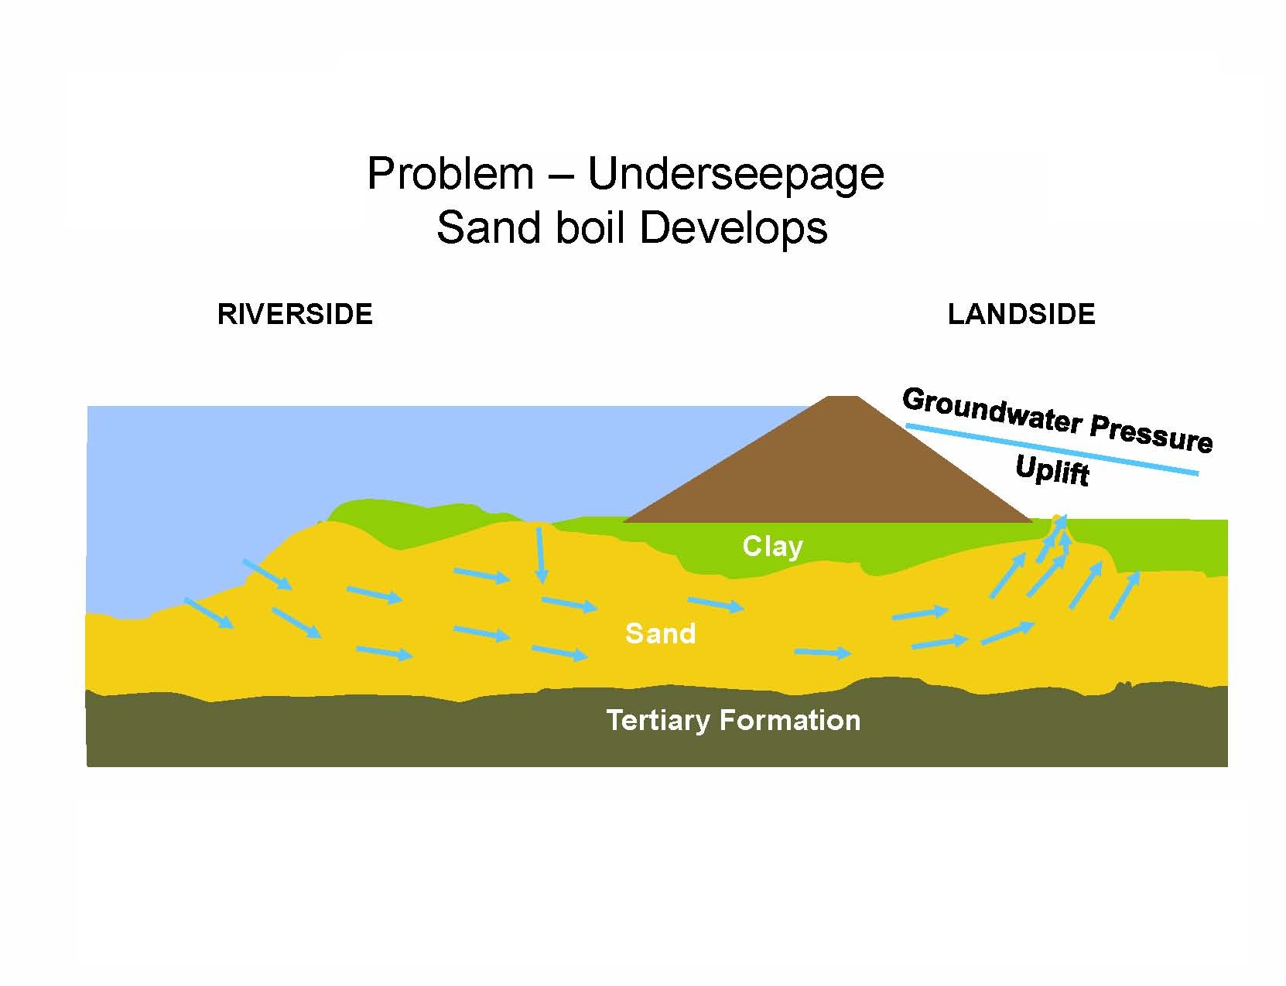
Underseepage –
Formation of Sand Boils
Source: Cory Williams, P.E. – U.S. Army Corps of Engineers

Slide 18
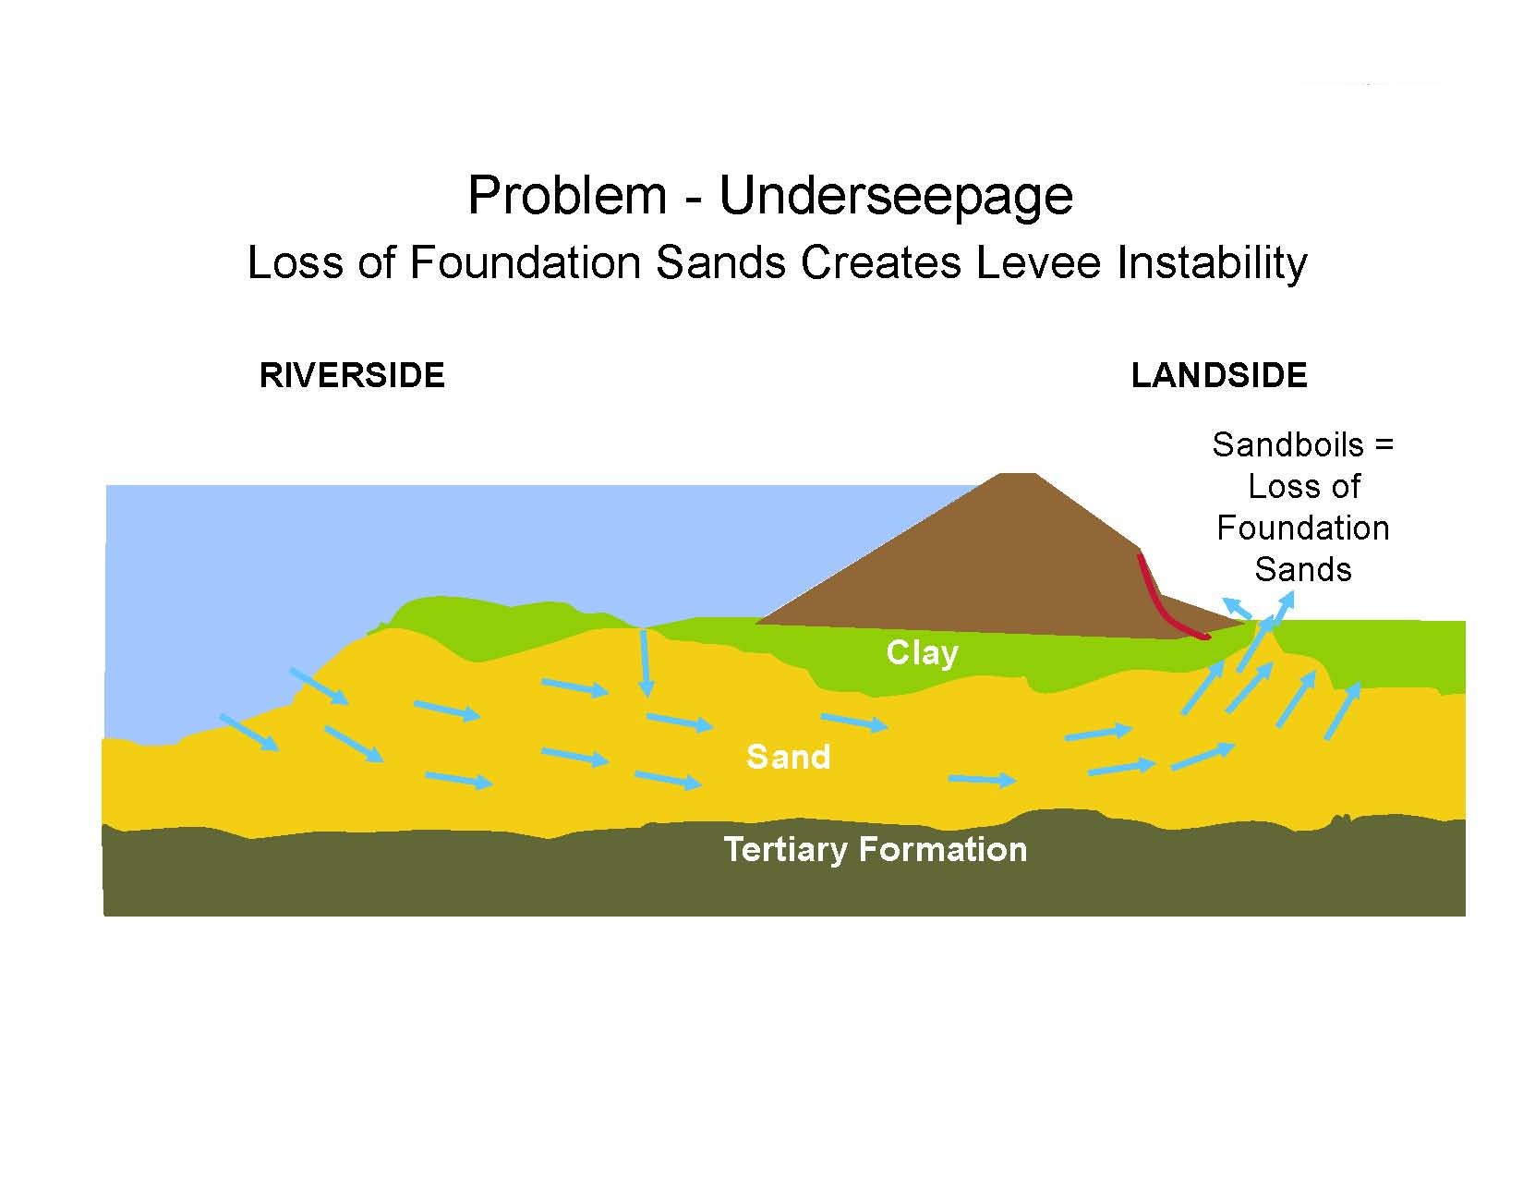
Underseepage Instability
Source: Cory Williams, P.E. – U.S. Army Corps of Engineers

Slide 19
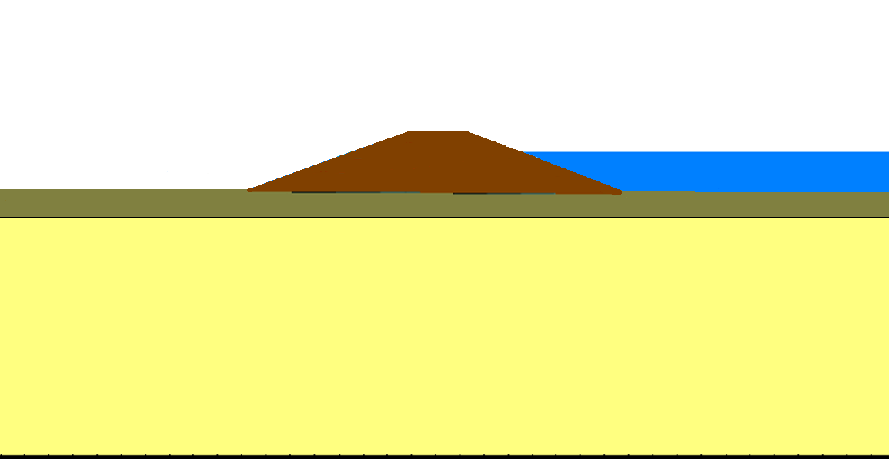
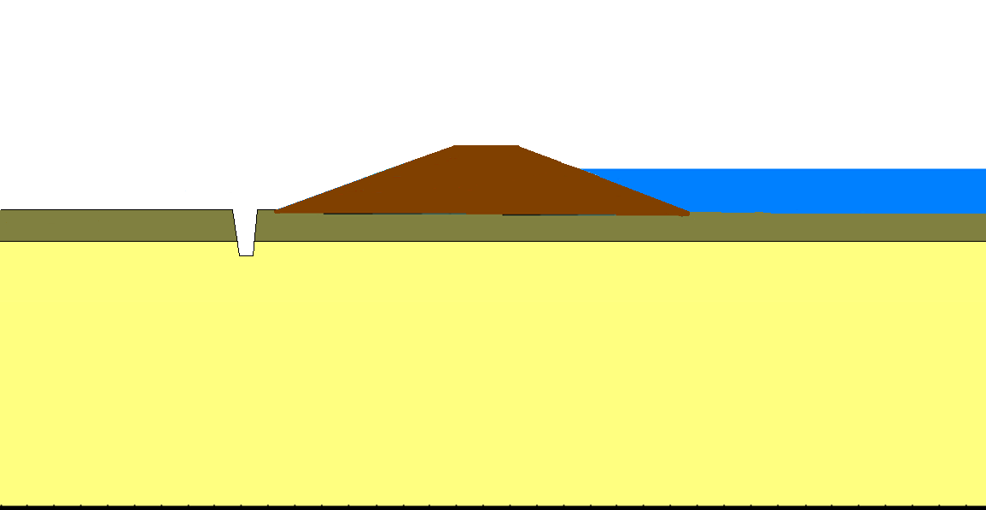

Semi-pervious Blanket
Levee
Aquifer
Semi-pervious Blanket
Levee
Aquifer
Scale: None
Drawn by: MG
Date: March 16, 2011
AMEC File No. 5-6317-0001
LEVEE ILLUSTRATION

Slide 20
Landside Berms
Advantages
Initial Cost
Maintenance
Disadvantages
Environmental Impacts
ROW requirements
Borrow sources
Increased pressures beyond toe
LANDSIDE
RIVERSIDE
Clay
Sand
Tertiary Formation

Slide 21
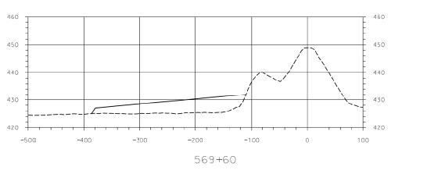
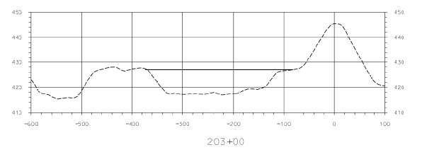
SEEPAGE BERM
Adds weight to landside surface.
Abuts the levee.
Slopes away from levee.
SOIL FILL IN LOW SPOTS
Raises land surface.
Used to fill in ditches, borrow pits etc.
May not abut the levee.
Scale: None
Drawn by: LS
Date: March 16, 2011
AMEC File No. 5-6317-0001
WOOD RIVER
PLANS AND CROSS SECTIONS

Slide 22
Relief Wells
Advantages
ROW
Minimal Borrow & Environmental Impacts
Initial Cost
Disadvantages
Maintenance
Drainage required
LANDSIDE
RIVERSIDE
Without Well
Clay
With Well
Sand
Tertiary Formation
Tertiary Formation
Notes:
Purpose of Relief wells is to allow the seepage to occur in a more controlled environment
- Results in reduction in groundwater pressures within the area of influence of well while preventing foundation sands from being removed

Slide 23
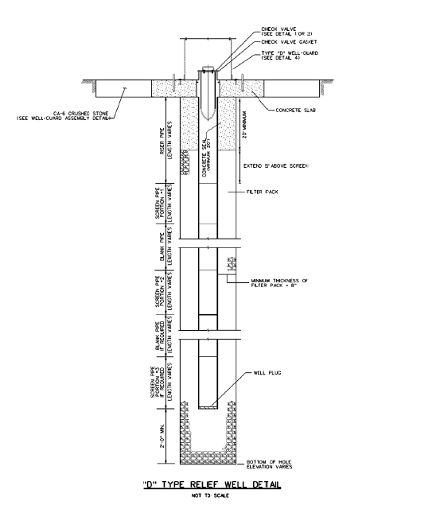
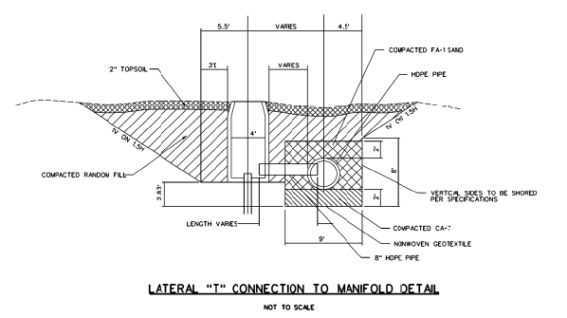
D-TYPE RELIEF WELLS
Water flows directly from the relief well.
T-TYPE RELIEF WELLS
Water flows from the relief well to a collector pipe below ground.
Collector connects several relief wells
Scale: None
Drawn by: LS
Date: March 16, 2011
AMEC File No. 5-6317-0001
WOOD RIVER
PLANS AND CROSS SECTIONS

Slide 24
Cutoffs / Slurry Trenches
Slurry Trench – Most effective method of seepage control
Advantages
Most Effective Seepage Measure
Addresses Through Seepage
ROW
Minimal Borrow
Environmental Impacts
Maintenance
Disadvantages
Initial Cost
Trench Stability
Construction Duration
RIVERSIDE
LANDSIDE
Clay
Sand
Tertiary Formation

Slide 25
CUTOFF WALLS- Narrow slots filled with slurry.
DEEP CUTOFF WALLS-Penetrate through the aquifer to bedrock
SHALLOW CUTOFF WALLS-Partially penetrate the aquifer
BEDROCK
Scale: None
Drawn by: LS
Date: March 16, 2011
AMEC File No. 5-6317-0001
WOOD RIVER
PLANS AND CROSS SECTIONS

Slide 28
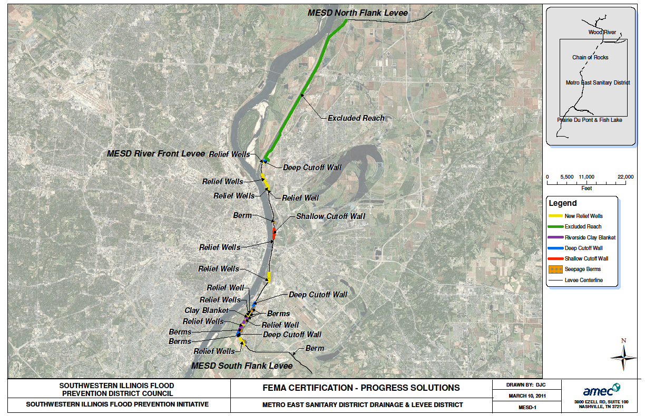

Slide 29
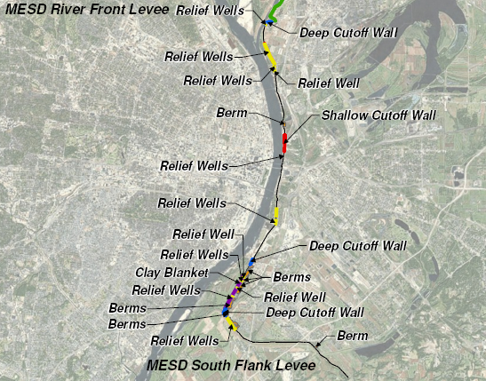

Slide 31
Uncertainties
Permitting
Certification of levees owned or improved by the Corps
Corps Levee Inspections
Weather
Financial markets
Costs

Slide 32
Need more information?
www.floodpreventiondistrict.org
Les Sterman
les@floodpreventiondistrict.org
618-343-9120

Slide 33
Questions/
Comments/
Suggestions?

