Slide 1
SW Illinois Flood
Prevention Project –
Progress Report
June 23, 2011
Southwestern Illinois Council of Mayors

Slide 2
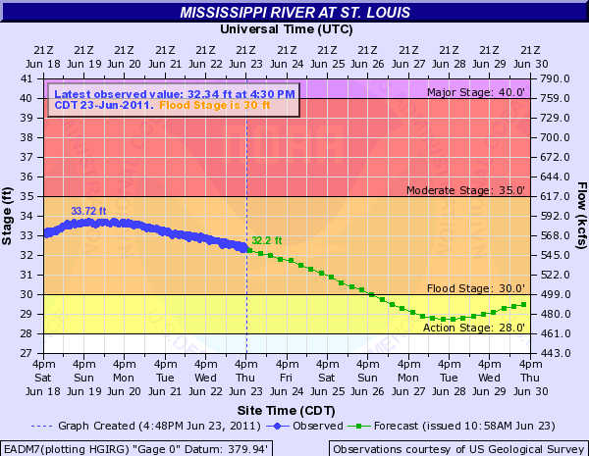
River Elevation 6.23.2011

Slide 3
SW Illinois Levee Systems
Designed and built in 1940’s and improved in ‘50s by Corps of Engineers as 500-year levees
Owned and maintained by Levee Districts
  Wood River Drainage and Levee District
  Metro-East Sanitary District
  Prairie DuPont Drainage and Levee District
  Fish Lake Drainage and Levee District
Owned and maintained by Corps
  Chain of Rocks Levee

Slide 4
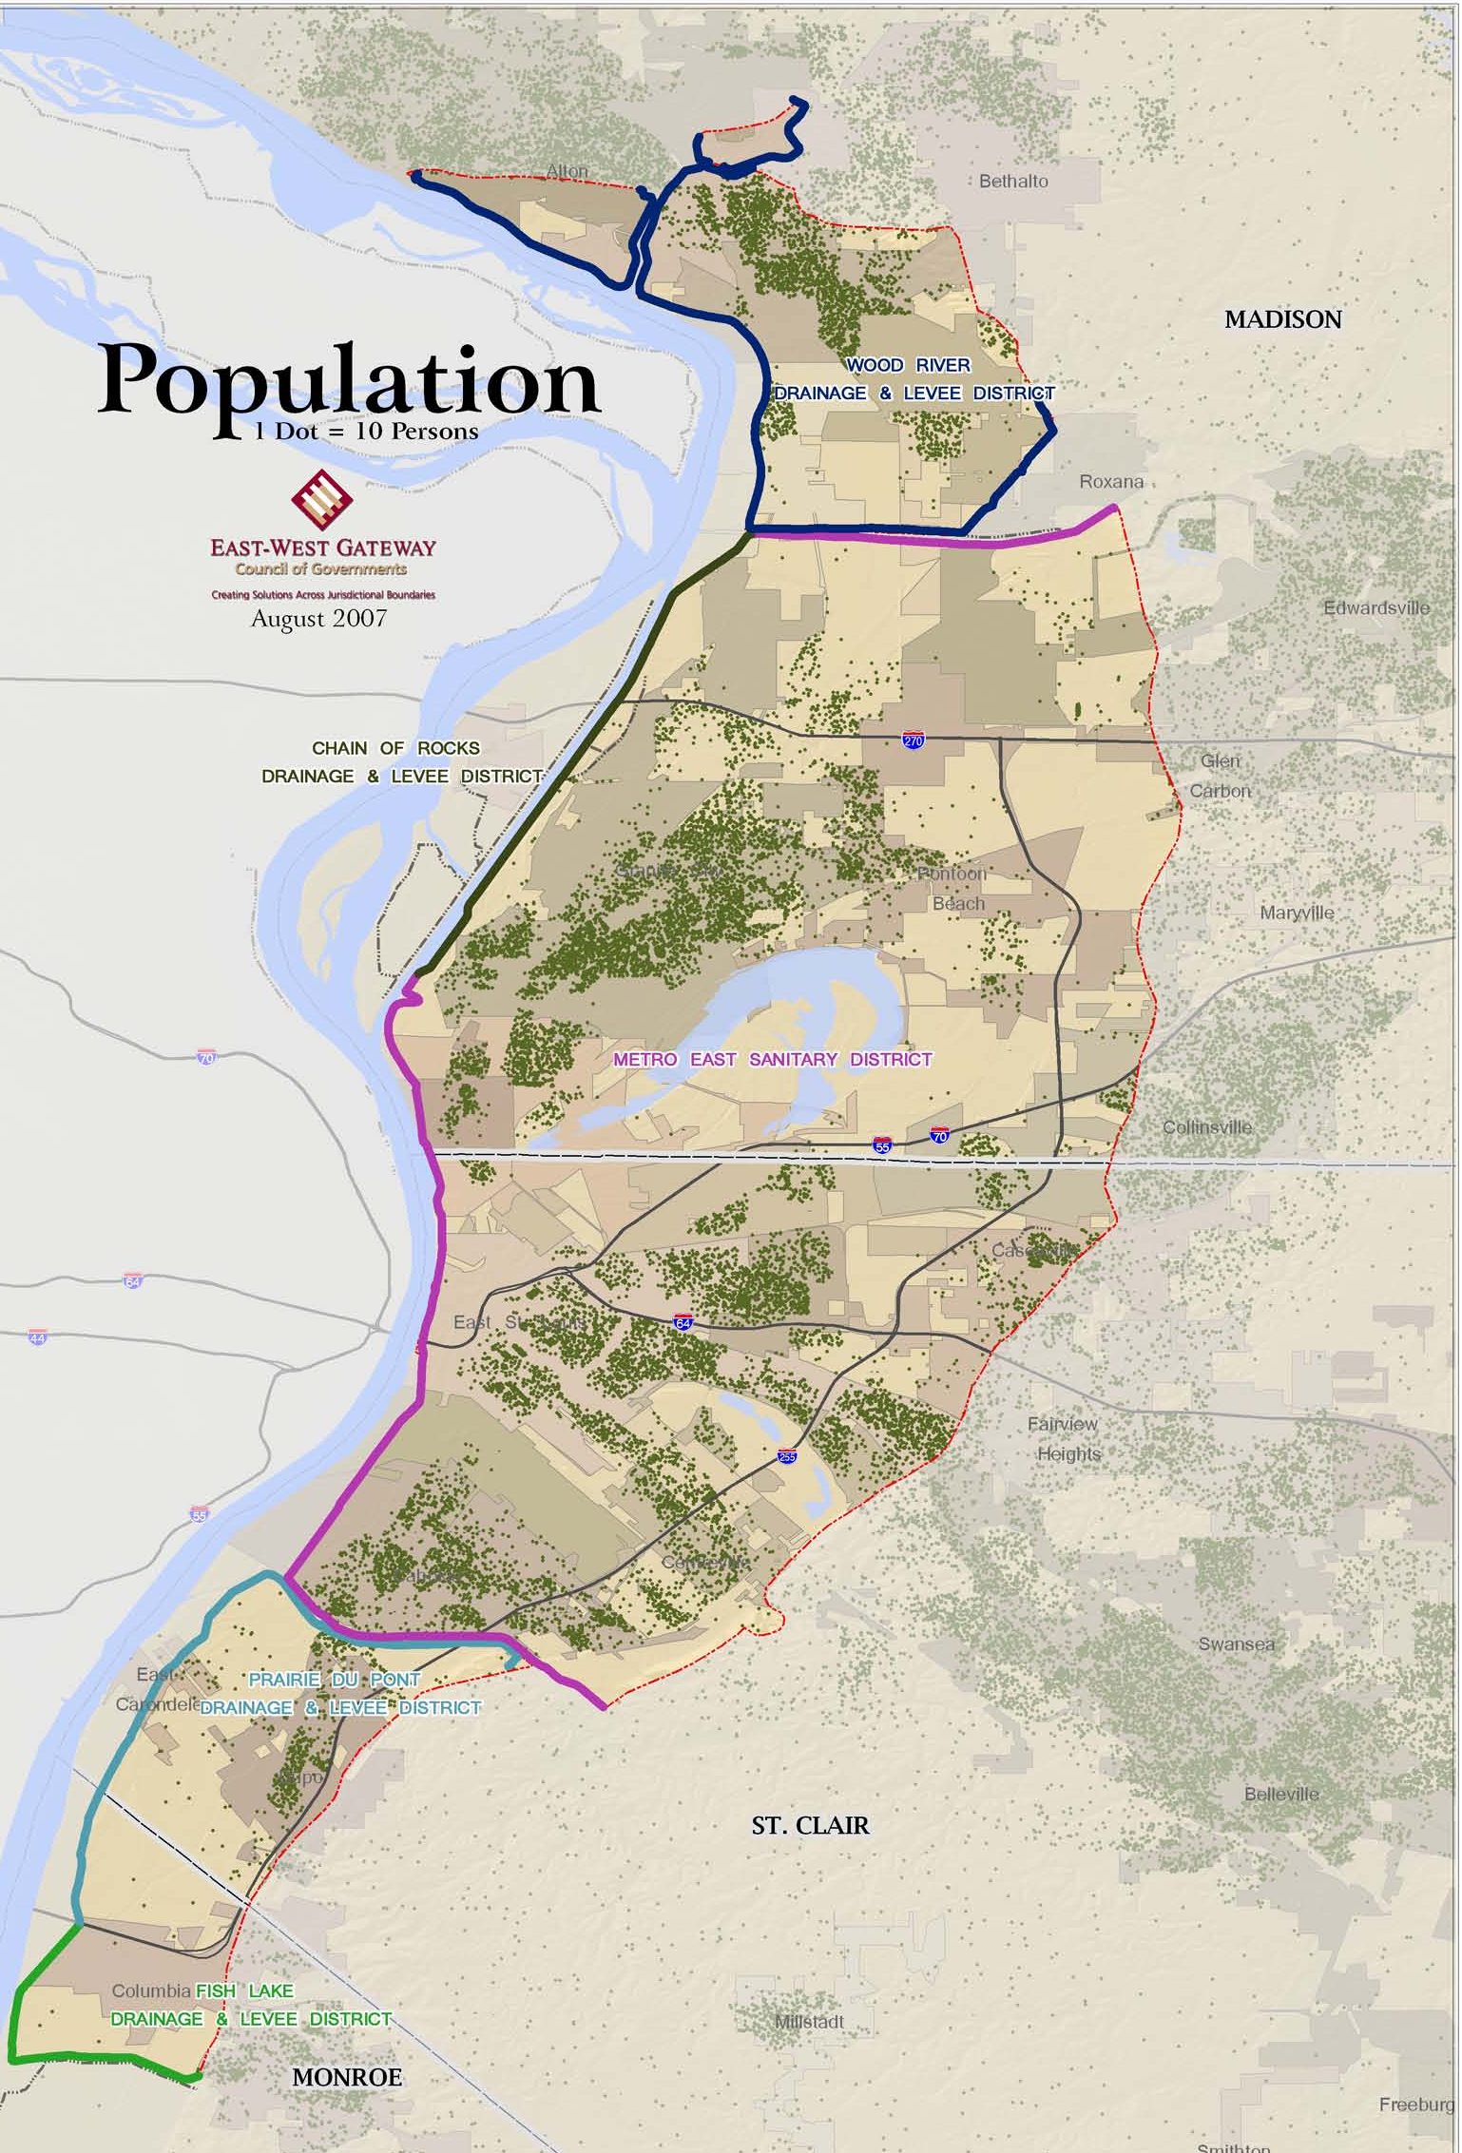
155,000 people
  40% minority
  21% low income
174 square miles
Longstanding and historic communities
  Alton
  Wood River
  Granite City
  East-St. Louis
  Columbia
  Dupo
  East Carondelet
  Collinsville

Slide 5
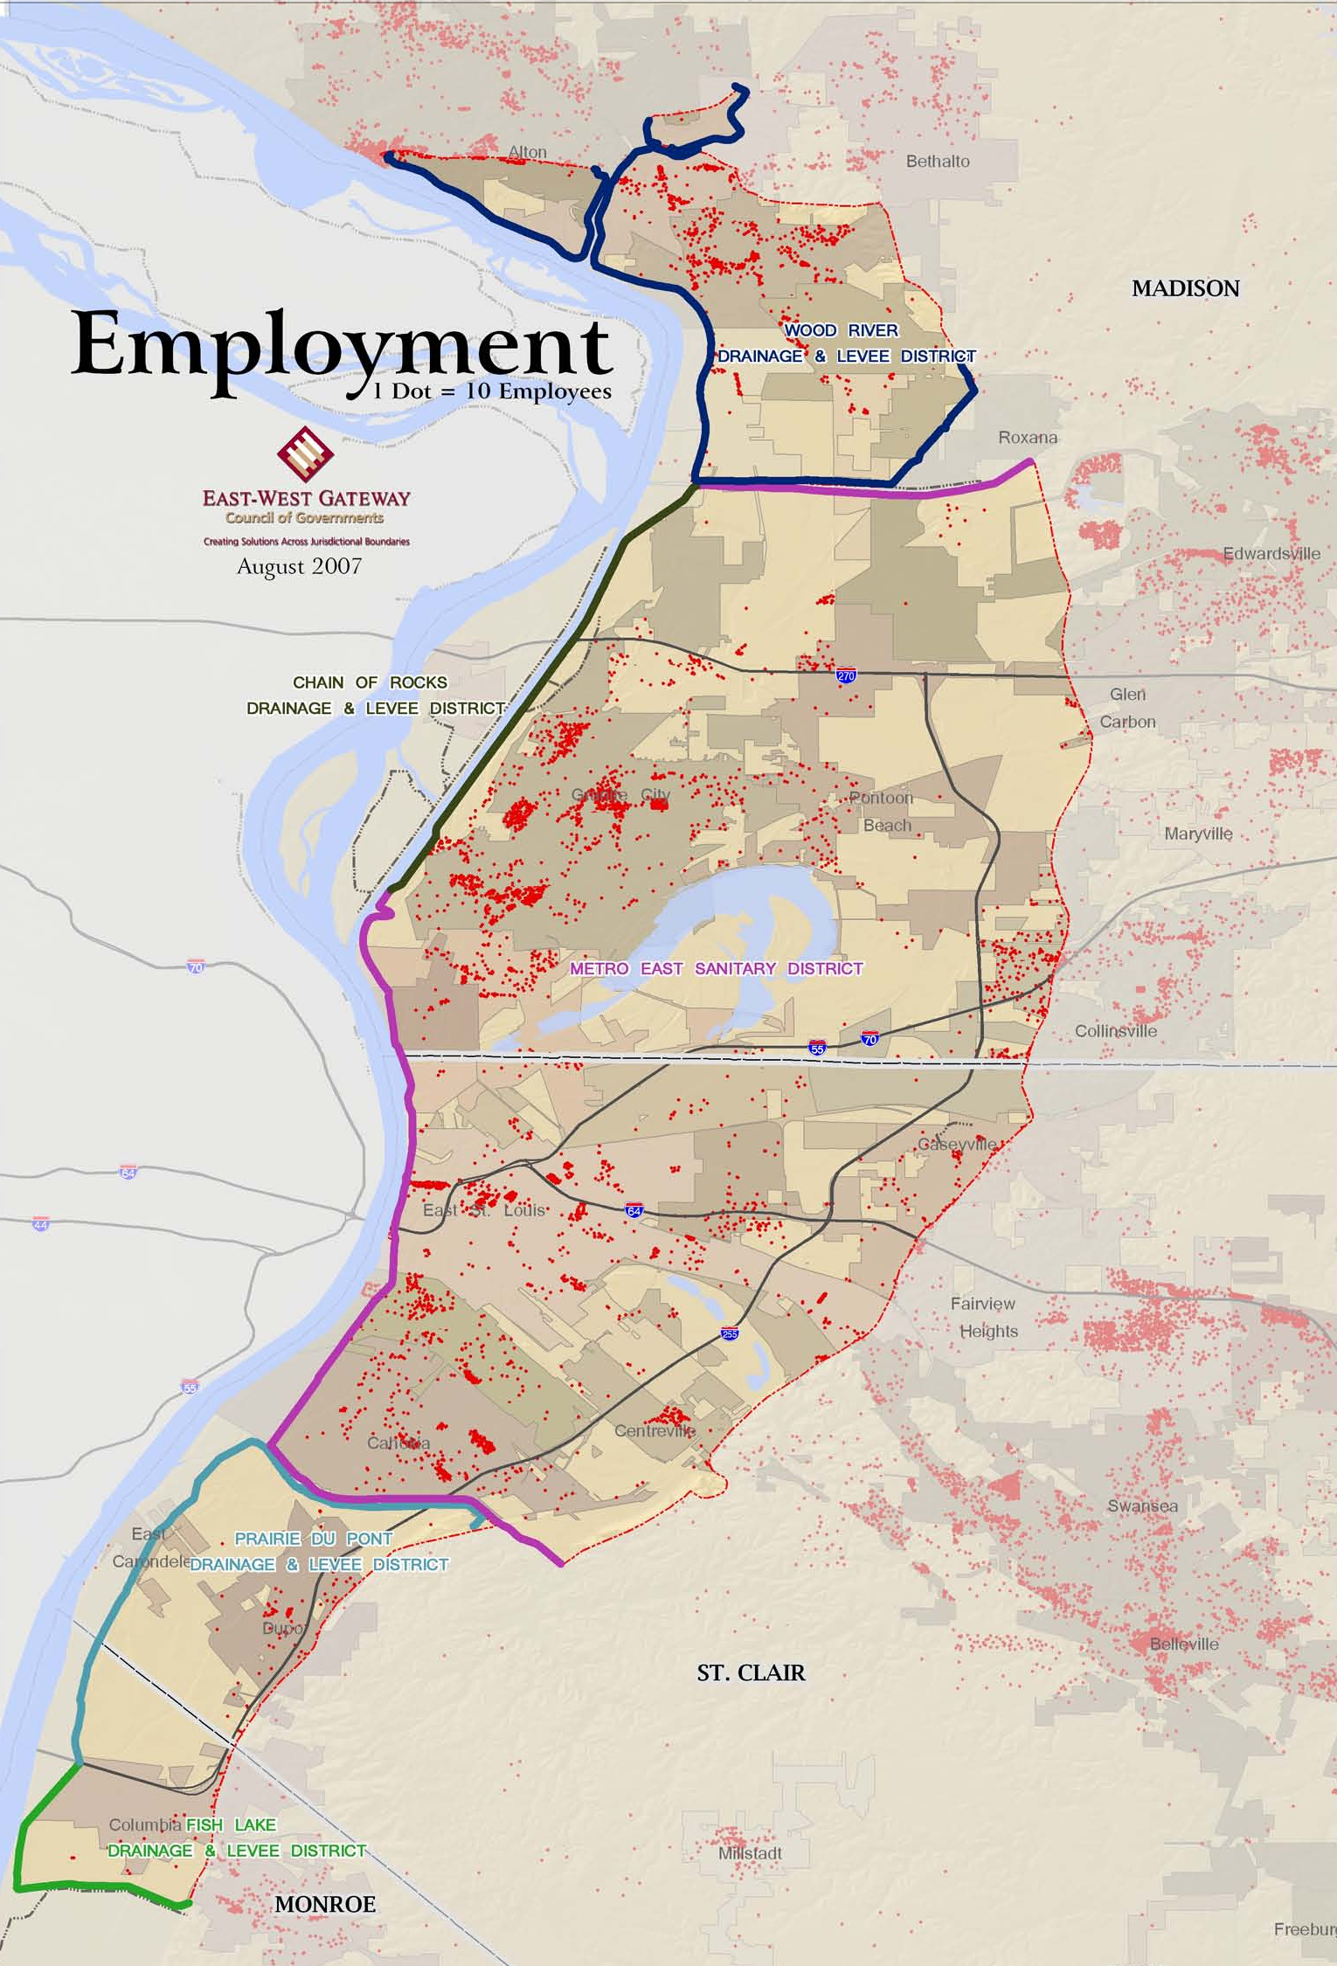
Industrial core of the St. Louis region
55,000+ jobs
  Conoco – Phillips
  U.S. Steel
  Solutia
  Afton Chemical

Slide 6
The Problem
Corps of Engineers identified Design Deficiencies that may compromise the “authorized level of protection” (52 + 2 feet on St. Louis gauge – approx. 500-year)
  Understanding of risk has improved
  Better design methods
  Increased design factor of safety post-Katrina
FEMA decides to de-accredit the levee system
“Fear, uncertainty, and doubt” about flood protection erodes the economic security of Metro-East

Slide 7
Economic Impacts
Mandatory Flood Insurance
  $20 million/yr additional premiums for homeowners and businesses
  Another $30 million/yr for larger businesses
Building Standards
  Raise buildings above base flood elevation
Loss of Property Value
Negative Business Climate

Slide 8
Opportunity
Resurgence of manufacturing
Intergovernmental success story
Renewed marketing opportunities

Slide 9
Key Terms
Local levee owners (or the Corps) must certify that levee systems will meet federal standards for protecting from a flood with a probability of 1% likelihood of occurring in one year (100-year flood).
FEMA accredits levee systems that have been certified to meet federal standards.

Slide 10
Progress…
FEMA announces deaccreditation – August 2007
Haine introduces legislation to impose tax and create Flood Prevention Districts – November 2007
Illinois Flood Prevention District Act signed into law – May 2008

Slide 11
Progress…
County FPDs are appointed – June 2008
Tax approved by county boards - July-Sept 2008
Tax collections start – January 2009
Corps concludes project to be finished in 2044 – May 2009
Intergovernmental Agreement signed June 2009
First meeting of FPD Council – June 2009
FPD staff hired – July 2009
Authorize challenge of FIRMS – August 2009

Slide 12
Progress…
Select financial advisor – September 2009
Adopt project strategy – September 2009
Begin levee inspection – December 2009
Select consultants for design competition – December 2009
Issue RFP for design competition – February 2010
Select design consultants – June 2010
Begin design process - 2010

Slide 13
Progress…
File suit against FEMA – November 2010
Issue $94 million in bonds – November 2010
Progress set of construction drawings – March 2011
30% design drawings – May 2011
Project implementation plan – June 2011
60% design drawings – December 2011
Construction begins – 1st Qtr. 2012 ?

Slide 14
Our goal…
Finish improvement of levee systems in three counties at a cost of about $160 million in five years (2015) or less
Limit economic hardship during the time that flood protection is being improved

Slide 15
Design Progress

Slide 16

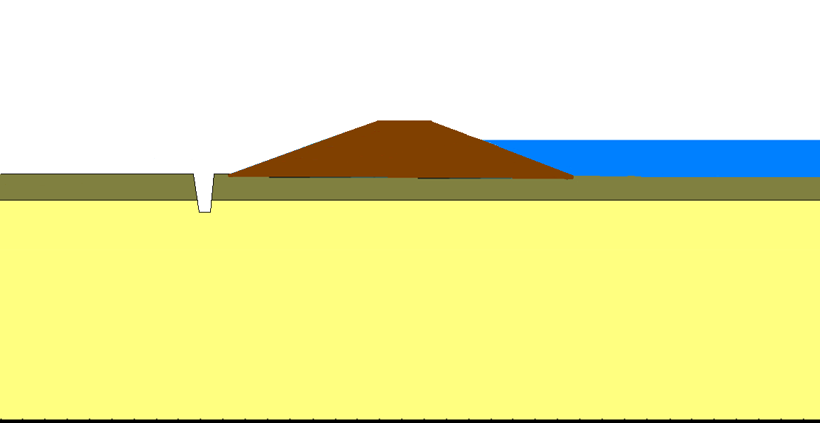

Semi-pervious Blanket
Levee
Aquifer
Semi-pervious Blanket
Levee
Aquifer
Scale: None
Drawn by: MG
Date: March 16, 2011
AMEC File No. 5-6317-0001
LEVEE ILLUSTRATION

Slide 17
CUTOFF WALLS- Narrow slots filled with slurry.
DEEP CUTOFF WALLS-Penetrate through the aquifer to bedrock
SHALLOW CUTOFF WALLS-Partially penetrate the aquifer
BEDROCK
Scale: None
Drawn by: LS
Date: March 16, 2011
AMEC File No. 5-6317-0001
WOOD RIVER
PLANS AND CROSS SECTIONS

Slide 18
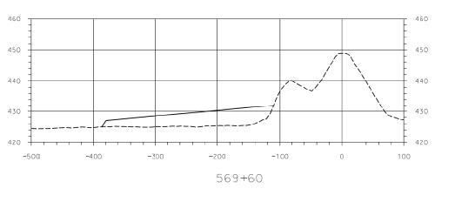
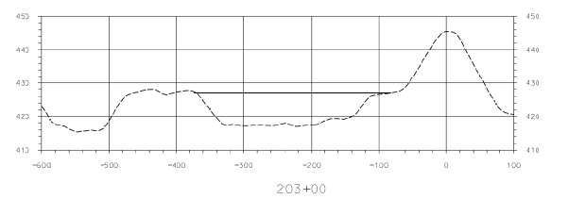
SEEPAGE BERM
Adds weight to landside surface.
Abuts the levee.
Slopes away from levee.
SOIL FILL IN LOW SPOTS
Raises land surface.
Used to fill in ditches, borrow pits etc.
May not abut the levee.
Scale: None
Drawn by: LS
Date: March 16, 2011
AMEC File No. 5-6317-0001
WOOD RIVER
PLANS AND CROSS SECTIONS

Slide 19
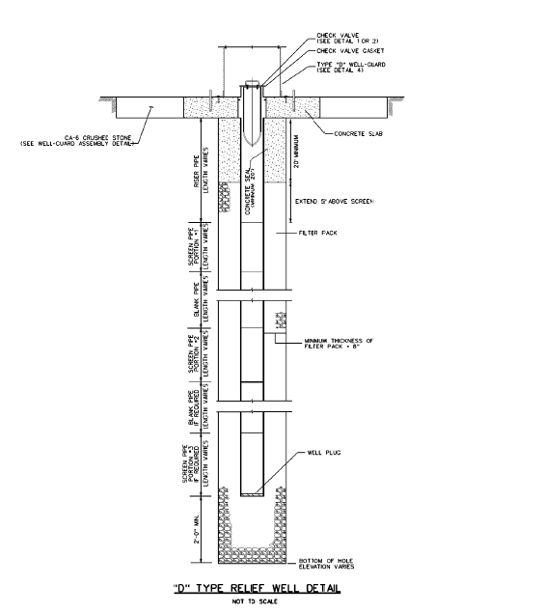
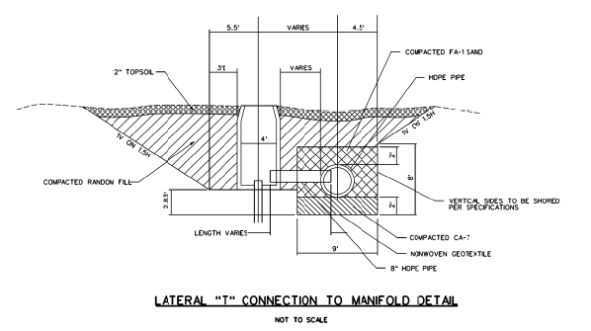
D-TYPE RELIEF WELLS
Water flows directly from the relief well.
T-TYPE RELIEF WELLS
Water flows from the relief well to a collector pipe below ground.
Collector connects several relief wells
Scale: None
Drawn by: LS
Date: March 16, 2011
AMEC File No. 5-6317-0001
WOOD RIVER
PLANS AND CROSS SECTIONS

Slide 22
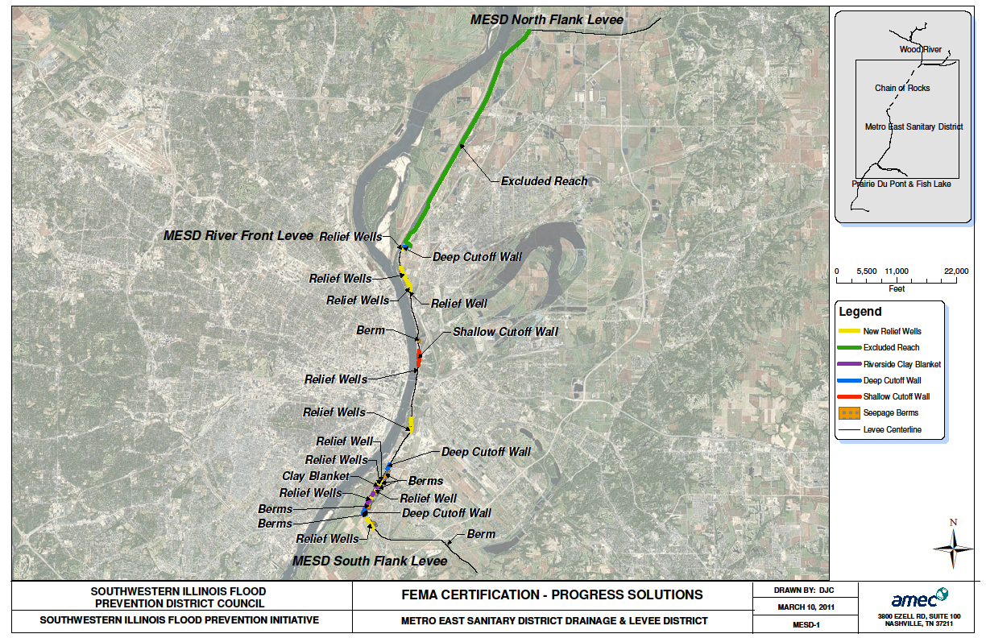

Slide 23
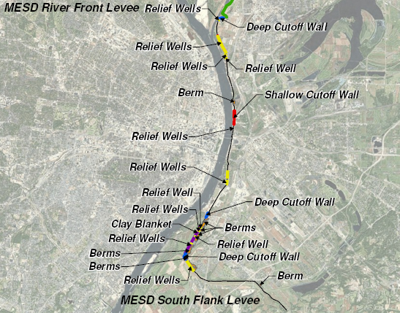

Slide 25
Uncertainties
Permitting
Certification of levees owned or improved by the Corps
Weather
Financial markets
Costs

Slide 26
Need more information?
www.floodpreventiondistrict.org
Les Sterman
les@floodpreventiondistrict.org
618-343-9120

Slide 27
Questions/
Comments/
Suggestions?

